Slide 1
Soil Moisture

Slide 2
Baseline
What particles make up soil? (3 different ones)
What is available water?
How do you think technology is used to manage soil water?

Slide 3
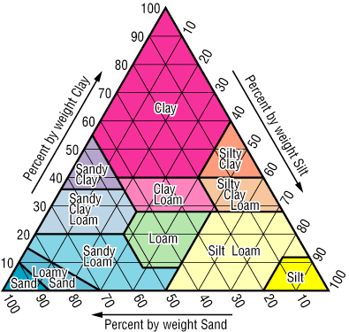
Soil Texture
Percentage of sand, silt, and clay in a soil
Can use hand method with ribboning or Web Soil Survey to help you determine soil texture of your area
Photo Courtesy of NASA Earth Observatory and Douglas Miller from the CONUS-Soil website
Notes:
Earth Matters - Who Cares about Soil Composition? Soil Scientist Douglas Miller for One (nasa.gov)

Slide 4
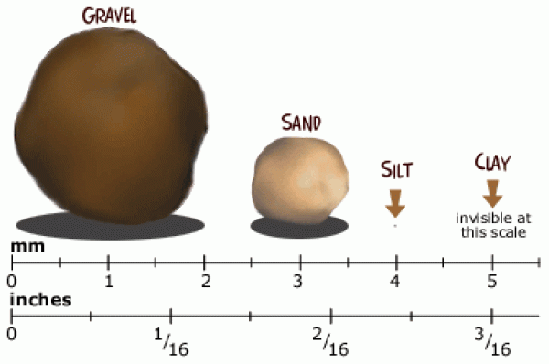
Soil Particles
Photo from CivilBlog.org
Notes:
Relative size of sand, silt and clay particles — Science Learning Hub
HOW TO IDENTIFY SILT & CLAY IN THE FIELD? - CivilBlog.Org

Slide 5
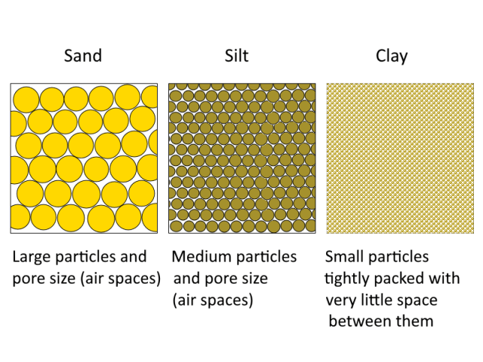
Soil Particles
Photo from Deep Green Permaculture
Notes:
Three Simple Soil Tests to Determine What Type of Soil You Have – Deep Green Permaculture

Slide 6
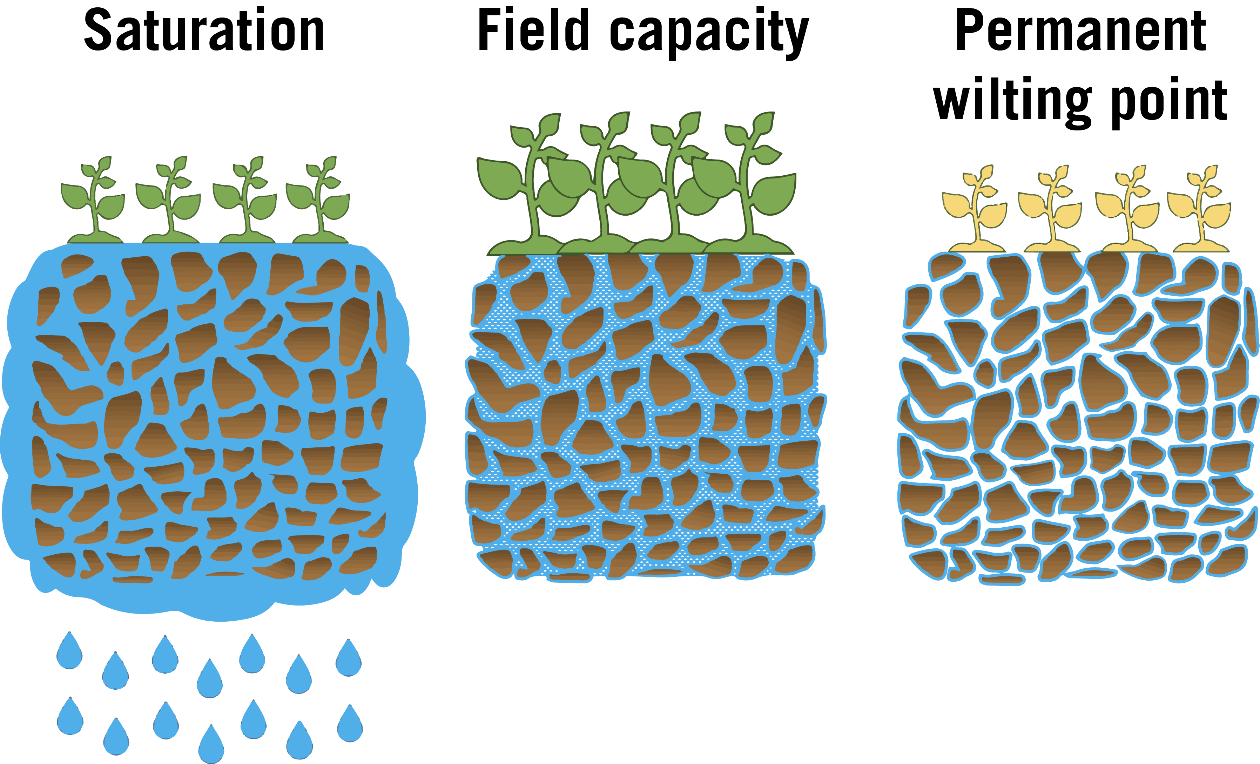
Soil Moisture Content
Photo Courtesy of UGA Cooperative Extension
Notes:
Water Holding Capacity - The Daily Garden
Principles of Irrigation and Scheduling for Vegetable Crops in Georgia | UGA Cooperative Extension

Slide 7
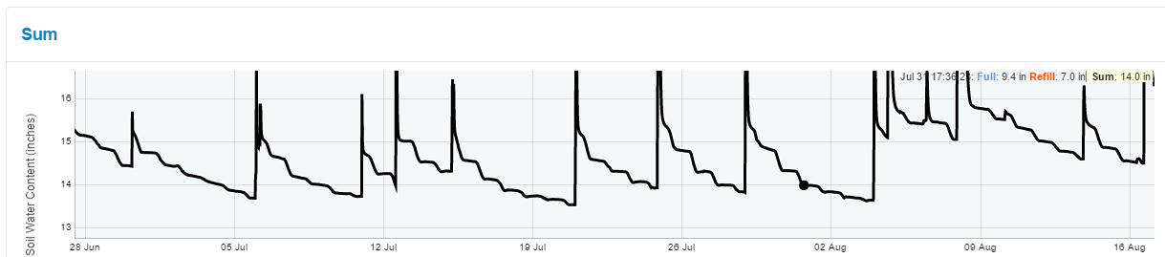
Real World-CropX
Photo Courtesy of Precision Agronomy Solutions
Notes:
CropxWeb

Slide 8
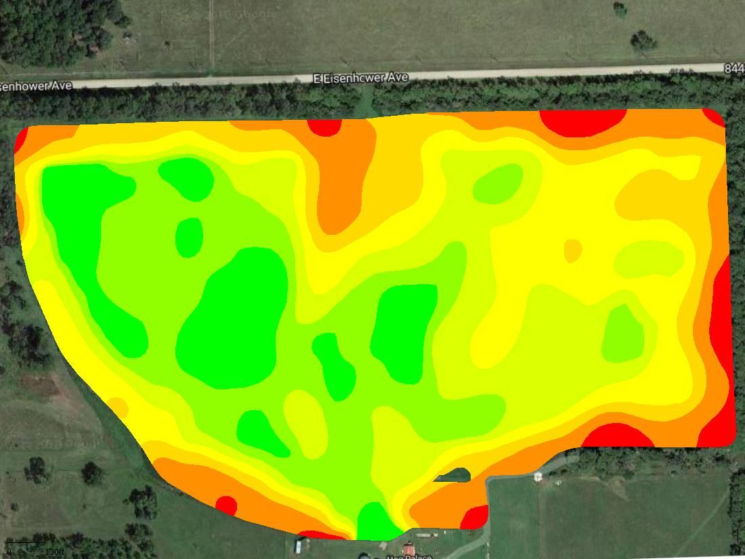
Yield Map
Dark Green—Optimum
Light Green—2nd Highest
Yellow—3rd Highest
Gold—4th Highest
Orange—5th Highest
Red—Lowest
Photo courtesy of Northeast Community College
Notes:
Let’s look at two maps showing different characteristics of the same field and begin to understand how factors impact one another. Explain that this is an example of a yield map. We have a simple legend on the left to help guide you. On the next slide we have a corresponding subsoil moisture map.

Slide 9
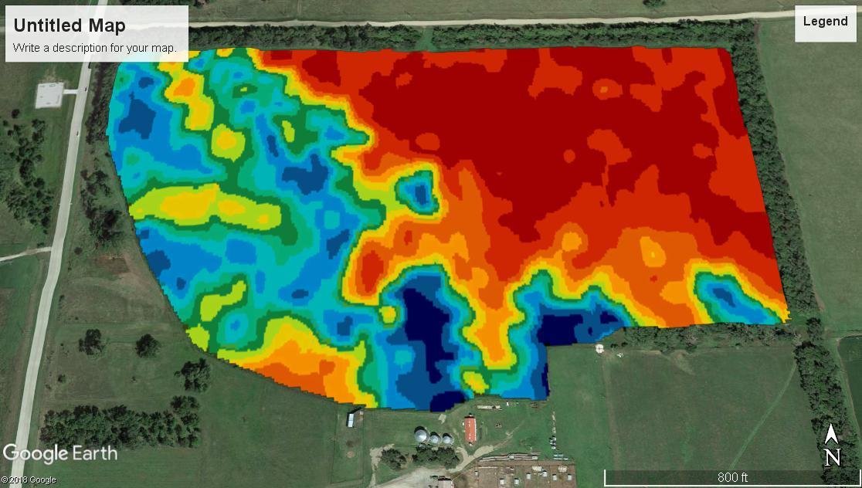
Corresponding Subsoil moisture Map
Dark Blue—highest amount of moisture in soil layer
Medium Blue—2nd Best
Light Blue—3rd Best
Dark Green—4th Best
Med Green—5th Best
Light Green—6th Best
Yellow—7th Best
Light Orange—8th Best
Dark Orange—9th Best
Red—Poorest
Photo courtesy of Northeast Community College
Notes:
On this slide, we have a subsoil moisture quantity map. I want you to notice and understand how to look at two different aspects of the same field and compare the too. That is actually what we are going to do right now (hit next slide).

Slide 10
Analyze the Maps (Mingle/Pair/Share)
Compare the soil moisture and yield maps
What similarities are there?
What could account for these similarities?
What differences are there?
What could account for those differences?
Side by side comparison on the next slide!

Slide 11
Compare & Contrast
Subsoil moisture map: Blue is the best soil and red is the worst
What accounts for these similarities and differences?
Yield map: Dark green is the best and red is the worst
Notes:
You will notice in this simple example that the trend appears to be that the yields are better in the areas where there is more amounts of subsoil moisture. This makes sense. Also, there is a slight slope to this field and the east end of the field is the slope of the hill. That area is also sandier, so it won’t hold as much water. Of course, these are details that you can’t see in these maps, but these are the kind of things you can begin to make assumptions about by seeing these pieces of data.

Slide 12
Revisit
What particles make up soil? (3 different ones)
What is available water?
How is technology used to manage soil water?

Slide 13

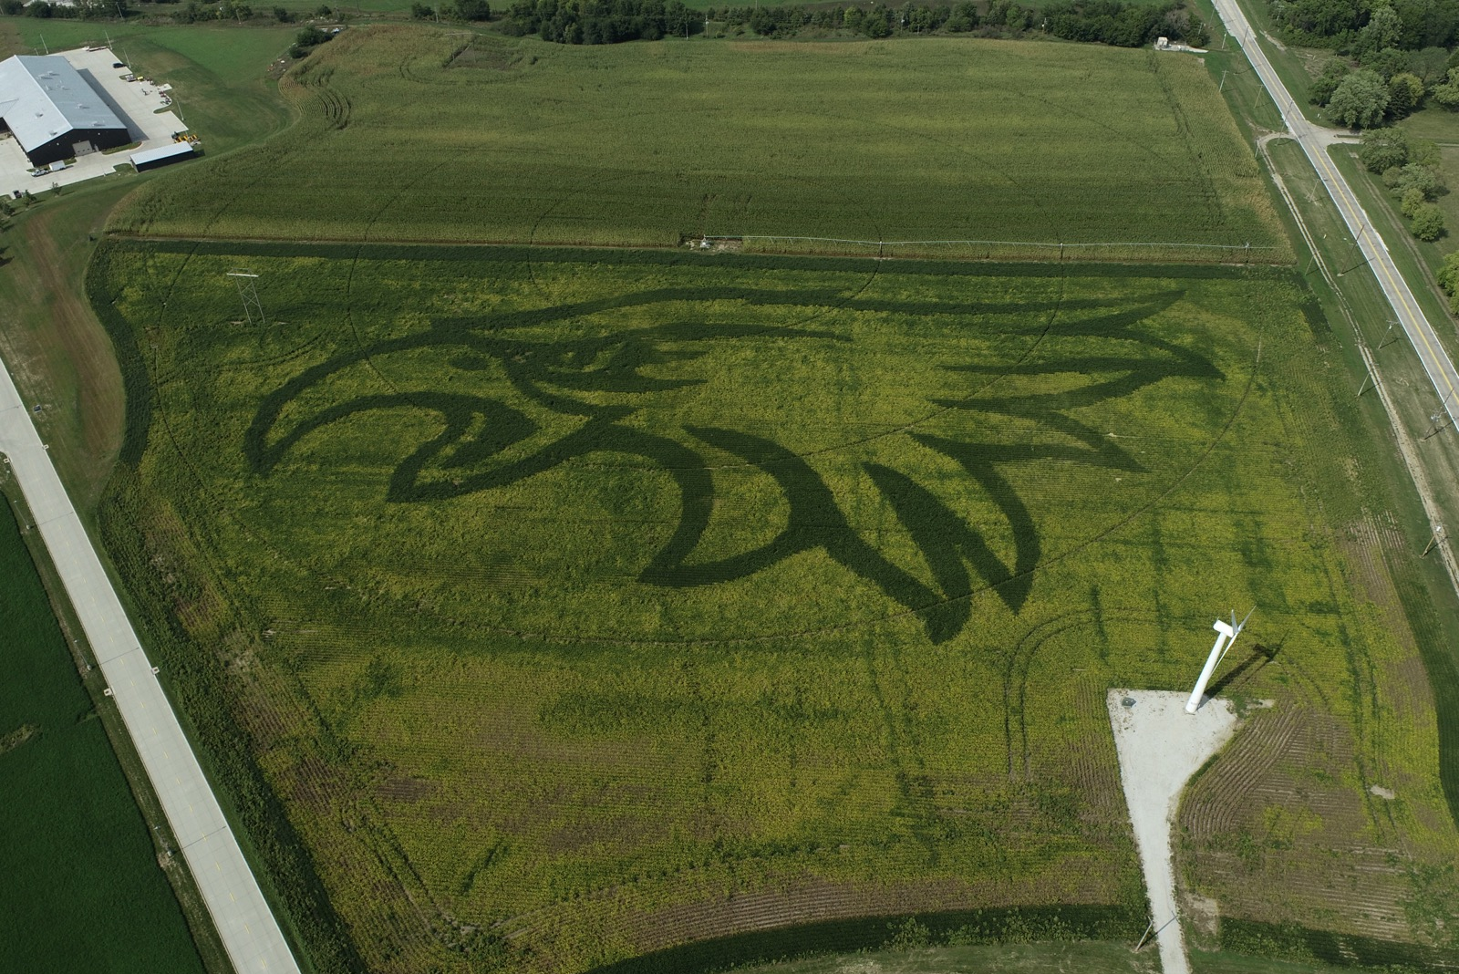
THANK YOU
Courtney Nelson
Precision Agriculture Trainer
cnelson10@northeast.edu
Photos courtesy of Craig Chandler and Rob Thomas
Notes:
The hawk was done utilizing different prescriptions with different relative maturities.

Slide 14
Acknowledgments
This material is based upon work supported by the National Science Foundation under Grant No. 2202151. Any opinions, findings, conclusions, or recommendations expressed in this material are those of the author(s) and do not necessarily reflect the views of the National Science Foundation.
The CHS Foundation, funded by charitable gifts from CHS Inc., is focused on developing a new generation of agriculture leaders for life-long success. Together, with our partners, we are igniting innovation and driving excellence in agricultural education, cultivating high-impact programs for rural youth and accelerating potential for careers in agriculture. Learn more at chsfoundation.org.

