Slide 1
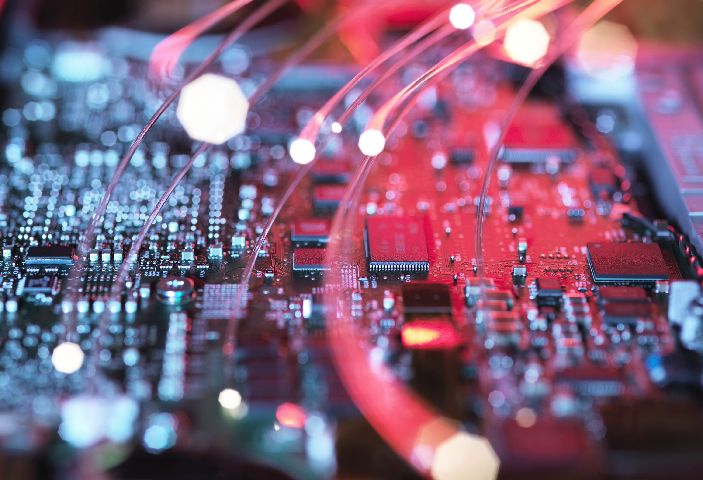
Precision ag
LESSON 2
Hardware/Software
The Fundamentals

Slide 2
Objectives:
Classify the differences and relationship between Hardware and Software
Understand what inputs can be controlled using precision agriculture.
Describe the fundamental components of precision agriculture technology to be prepared to dive deeper into specific precision ag technologies
Notes:
Last time, we introduced the concept of precision ag and how it is a method of farm management. It includes the components of information, technology, and management. We are going to explore some of the pieces of technology and tools we can use to help us make the management decisions that we will discuss deeper in future units.

Slide 3
Precision ag tools: the breakdown
Precision Ag Technology
Hardware
Meters
Monitors
Software/Data
GPS
GIS
Remote Sensing
Sensors
Notes:
This family-tree style breakdown helps you picture the different components that we will dive deeper into. It also allows you to see how each piece works together to fit in this precision ag puzzle. We will discuss each of these in further detail.

Slide 4
What is hardware and software?
Hardware
Software
Mechanical Equipment
Computer program that controls what the hardware does
Notes:
Any electronic technology system consists of hardware and software. Software can be on desktop, cloud, app on your phone.
Hardware: the physical equipment that we use such as planters and harvesters.
Software: the computer programming we use such as the drone program, etc.
Any electronic technology system consists of Hardware and Software
Hardware is the mechanical equipment
Software is the computer program that controls what the hardware does.

Slide 5
Let’s take a deeper look at sensors
Hardware
Meters
Monitors
Sensors

Slide 6
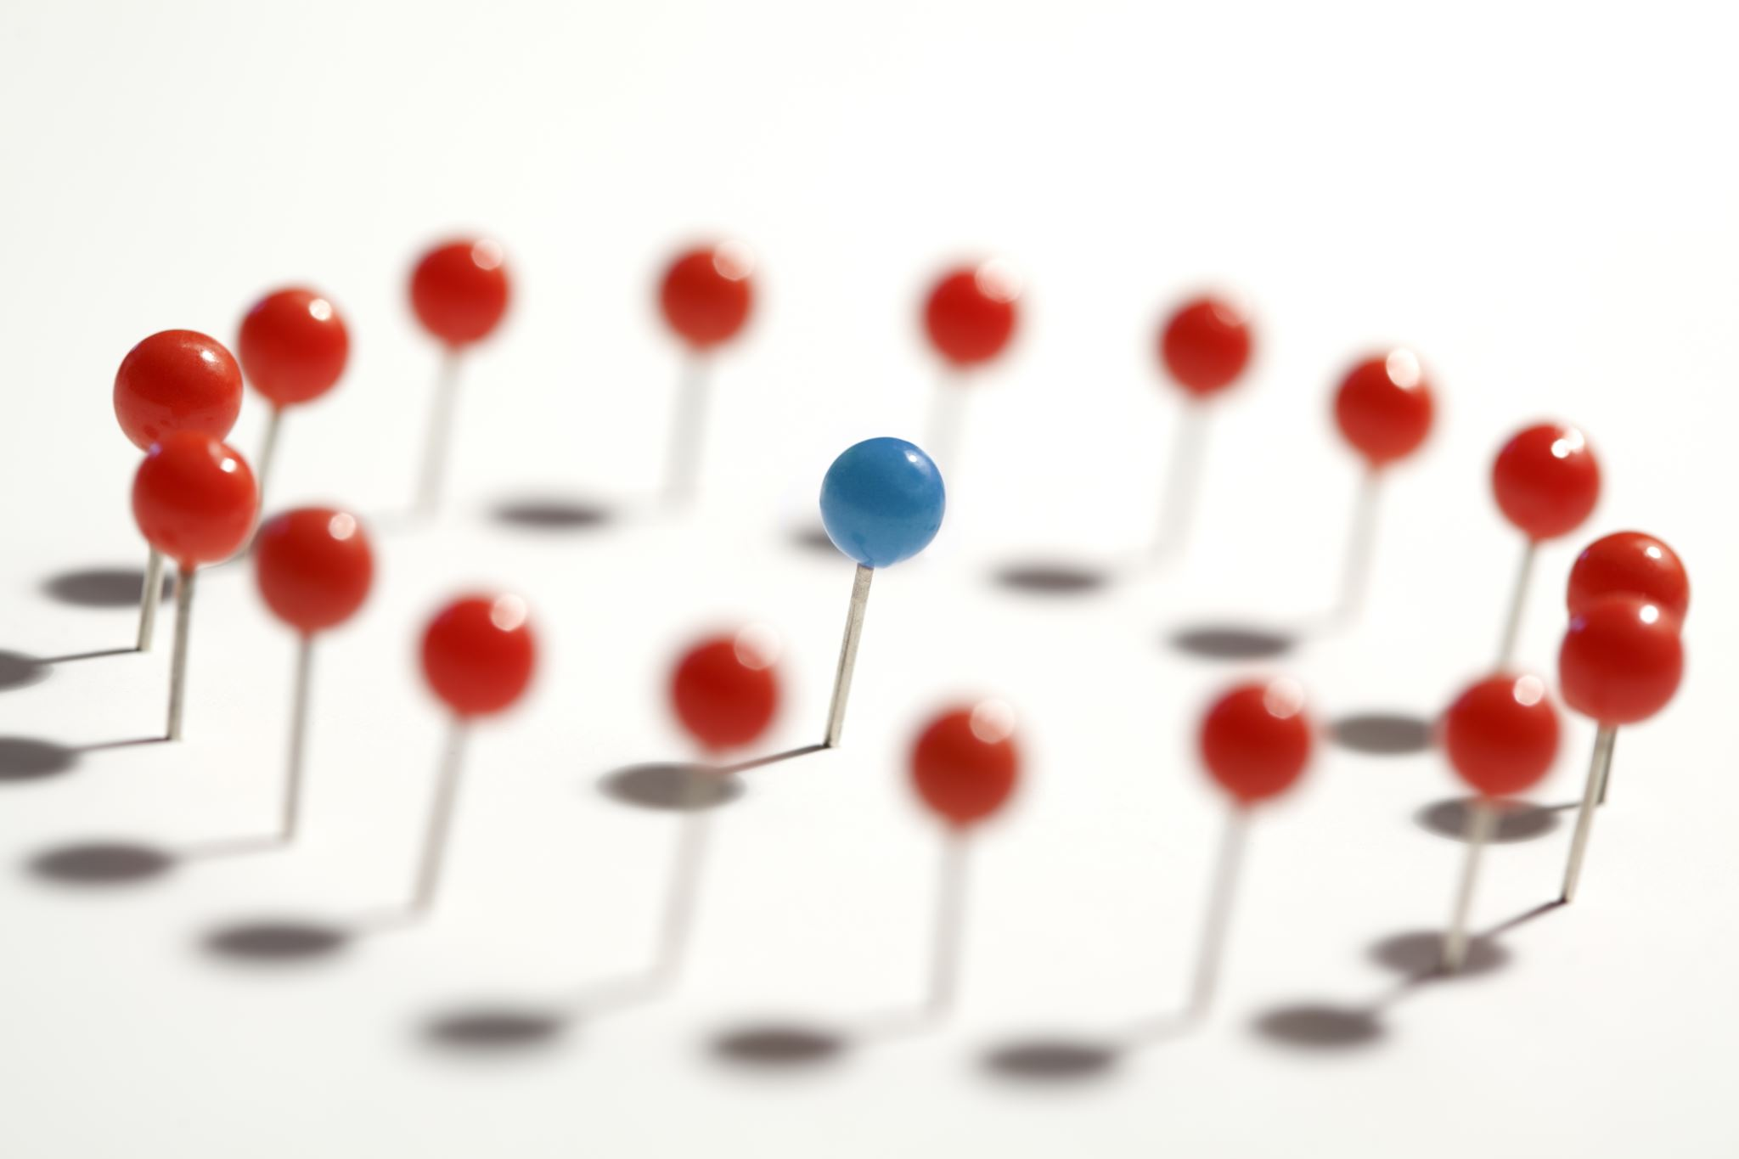
Sensors
Measure and collect data
Can use lasers, light emitters, thermometers, hygrometers, impact plates, scales, and gauges
Notes:
Sensors: your fit bits/smart watches on your wrist, thermometer for outside temps, or the speed sensors that tell you to slow down when you are rolling into towns (such as Humphrey on Hwy 81). These are all sensors.
They can collect data in a multitude of ways.

Slide 7
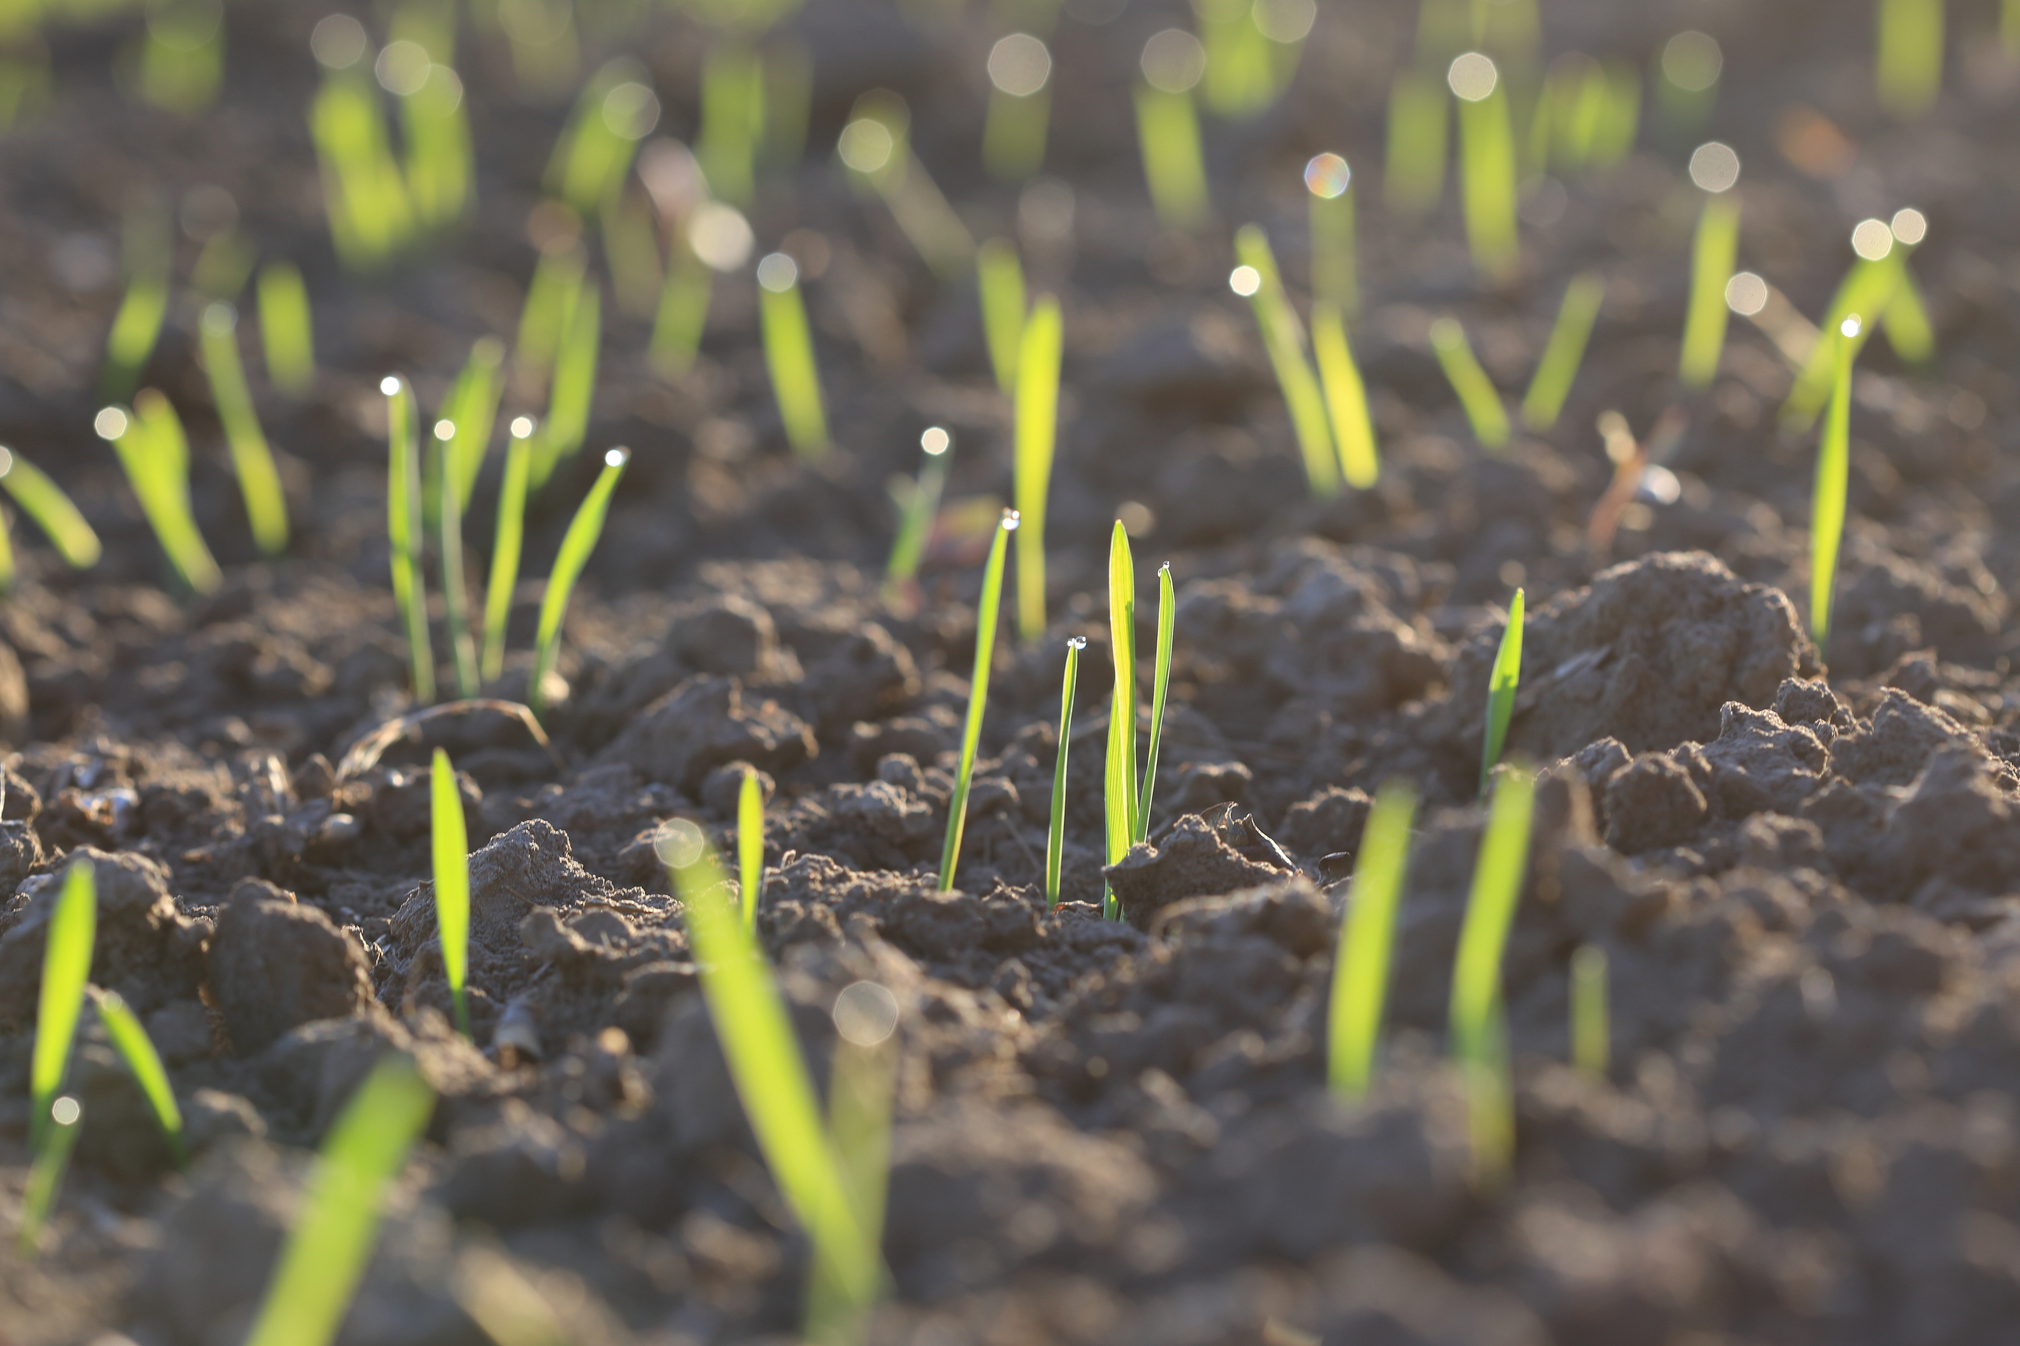

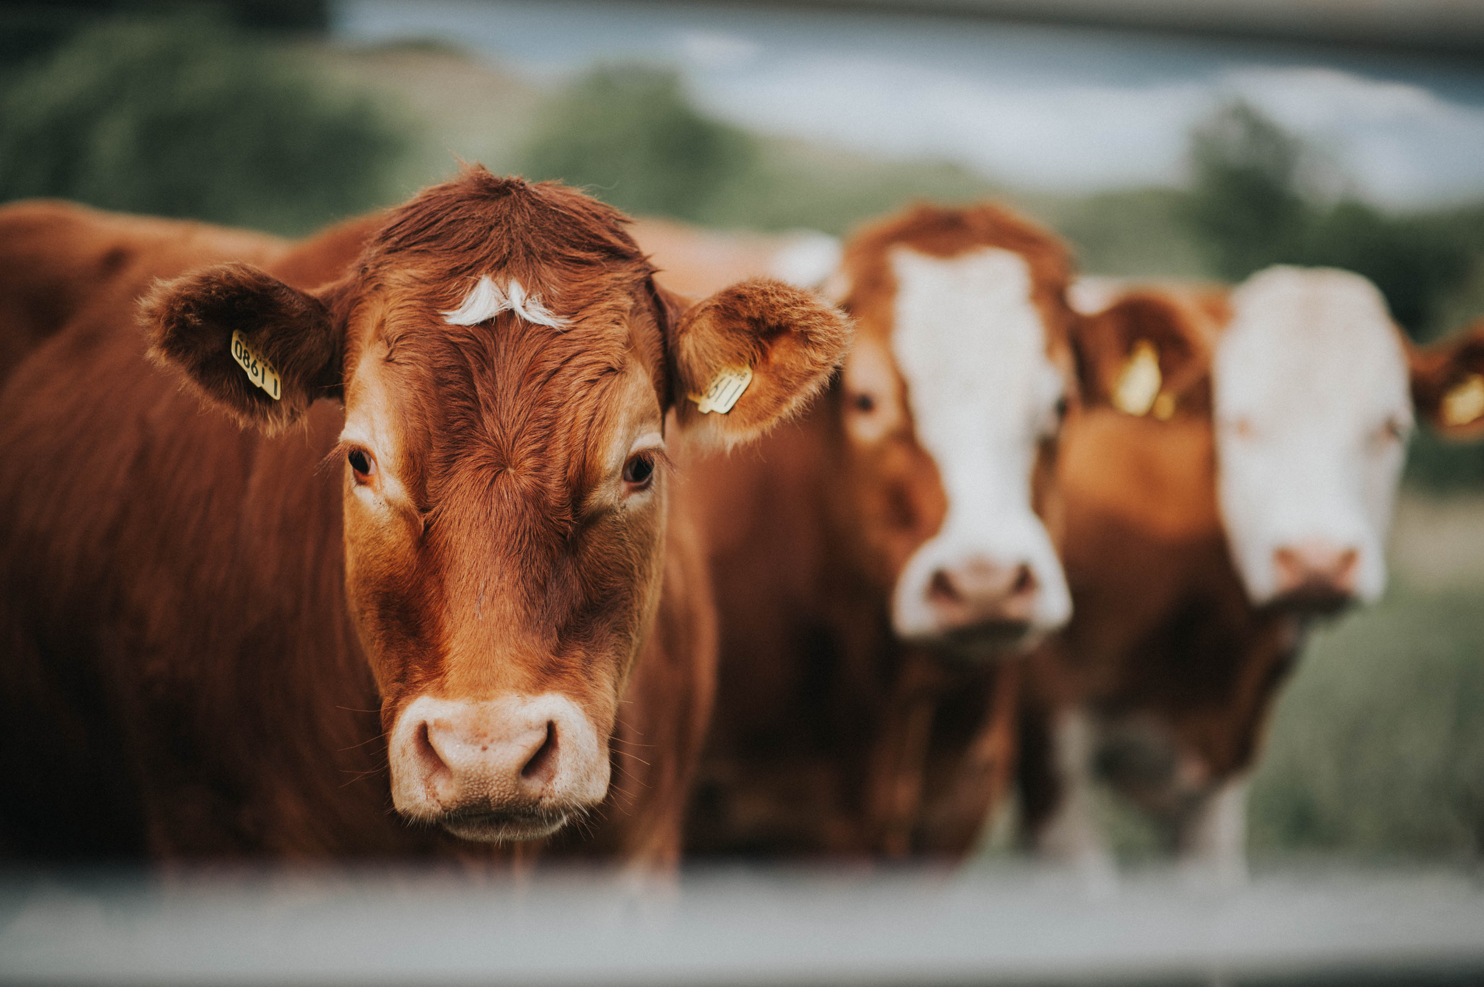
Sensors can monitor:
And so much more!
What are some other examples you can think of?
Notes:
locations on a map, how a seed is planted, how close the seeds are, if a seed is missing, if more than one seed is planted, soil moisture, soil pH, animal body temperature, animal’s number of visits to feed bunk, temperature, pressure, humidity, moisture, engine oil pressure, grain flow, etc.

Slide 8
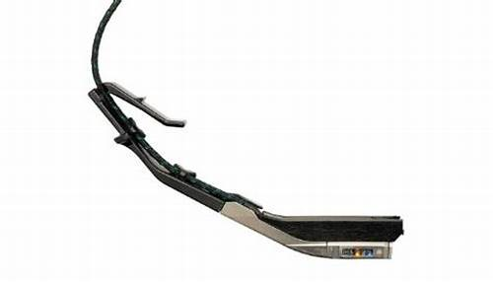
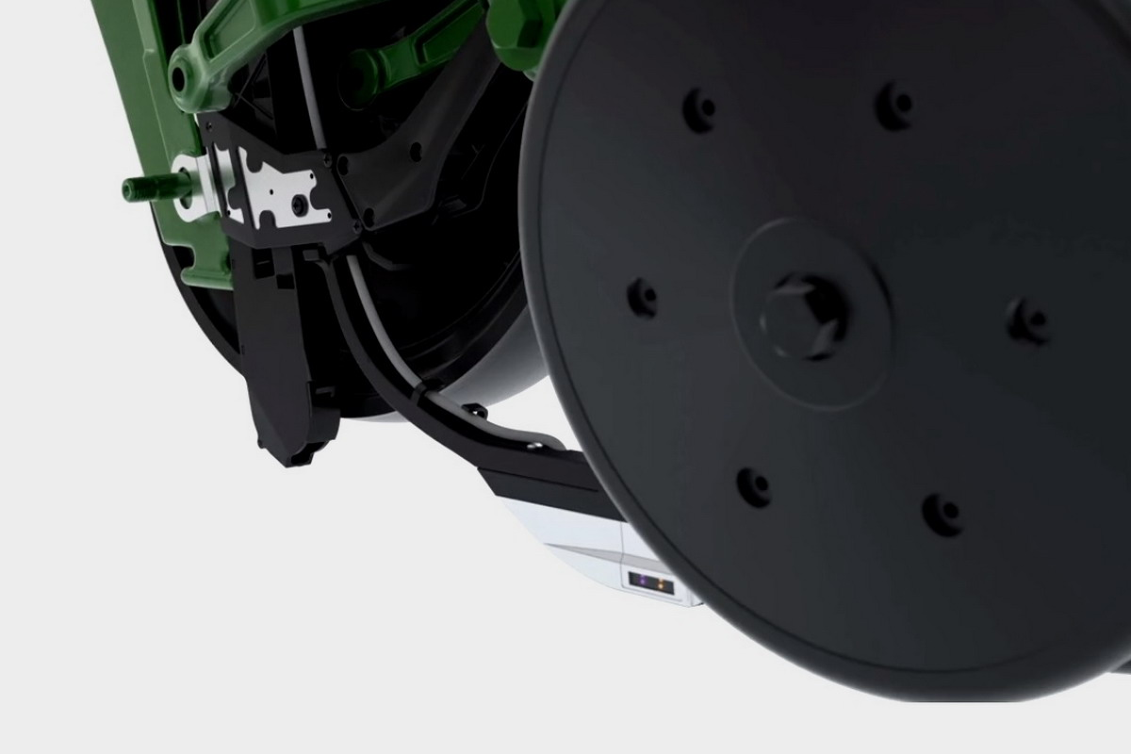
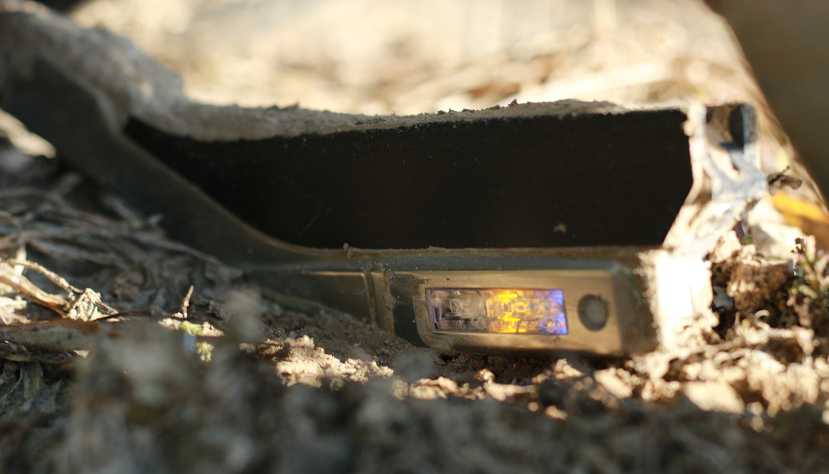
Sensors example:
Precision Planting SmartFirmer
A very complex highly technical set or “array” of sensors.
Check out Precision Planting’s website for videos explaining how the technology works!
Photos collected from Precision Planting’s website.
Notes:
When you open Precision Planting’s products page, scroll down until you see the words “SmartFirmer Gives Confidence”. Watch this video for a good explanation for how the technology works. Feel free to explore more on this site!

Slide 9
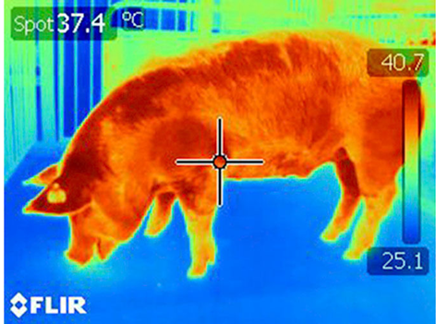
Sensors example:
Animal health tracking
What can be recorded?
    Location
    Food and water intake
    Body temperature
    Heart rate
Thermal imaging technology shows promise in determining heat tolerance for pigs and poultry.
Notes:
In the animal health world, we are beginning to be able to collect more data and understand animal health on a more precise level. We can use imaging technology or ear tags to give us the opportunity to monitor different characteristics. Some of those include: location, food and water intake, body temperature, and heart rate. Why would it be valuable to monitor those things? Well, if we have having problems with a disease in a herd, they can help keep it contained by potentially noticing disease sooner by seeing this data. They can track overall animal health and ensure everything is going smoothly.

Slide 10
Let’s take a deeper look at Meters
Hardware
Meters
Monitors
Sensors

Slide 11
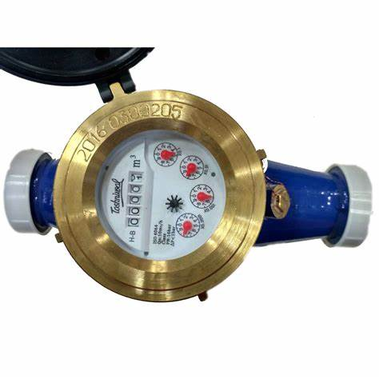
Meters
A meter measures and controls the amount of something that is applied through a system
Example: water flow meter on a pivot

Slide 12
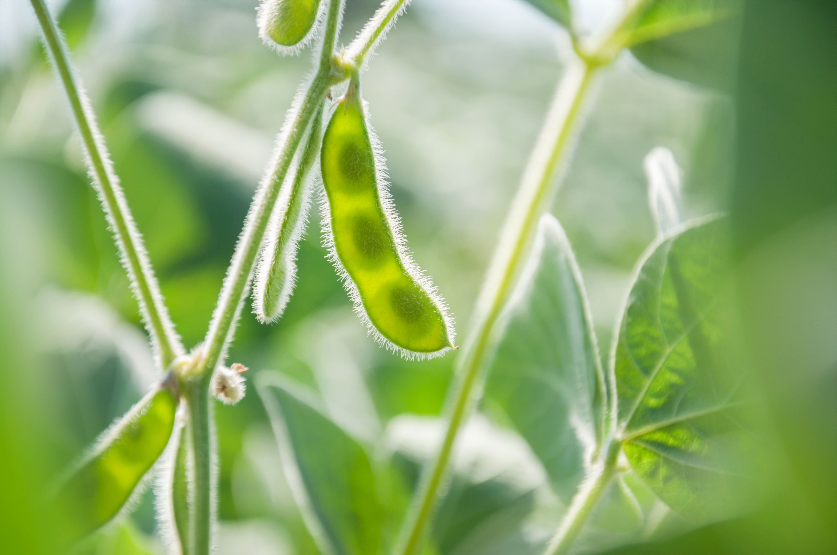
Meters
Allow users to vary the rate of delivery of “inputs” on the run
Uses a “prescription”
Spreaders, sprayers, planters, and irrigation units have meters that can vary application rates based upon prescriptions
Watch this short video to see how flow meters operate inside a system
Notes:
Give definition of “prescription”
The video is a minute and a half long animation of different types of meters. I show this to you just so you can see how water or material moves through a system. Don’t get tripped up by the specific types of meters.

Slide 13
Let’s take a deeper look at monitors
Hardware
Meters
Monitors
Sensors

Slide 14

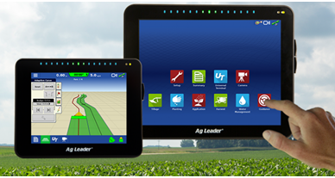
Monitors
A screen that shows the data being collected by the sensors and meters.
It can communicate this data with software
Examples:
Notes:
A piece of hardware that displays graphics and images used to observe, check, and keep records of a process or quantity
It communicates with software and other pieces of hardware to allow users to see and interpret what the different devices are reading
Changes to different settings can be done using the monitor and sent to the different devices, sometimes with the click of a button and some satellite signal!
Students should understand the concept of a monitor fairly easily as we see them in everyday life.

Slide 15
Now, Let’s talk about software
Precision Ag Technology
Hardware
Meters
Monitors
Software
GPS
GIS
Remote Sensing
Sensors

Slide 16
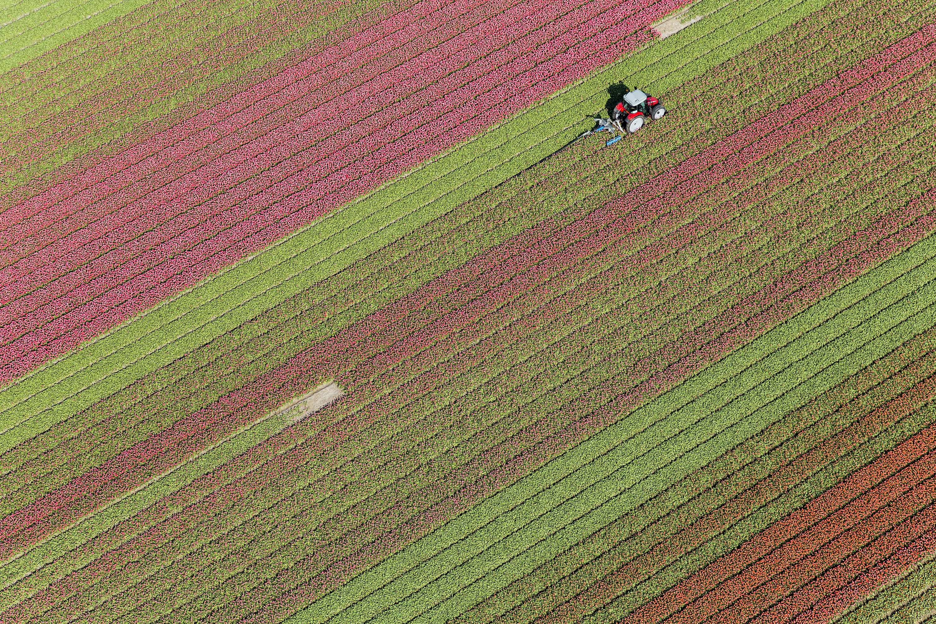
software
Keeps track of information gathered from hardware
  Throughout the season
  Across multiple years
Allows the operator to…
  Analyze data
  Make informed decisions to improve production
    “minimize” inputs to “maximize” outputs and profit
Notes:
Again, it is the computer programming that is used to run the different mechanical components (hardware) that we just discussed.
Think of your iPhone-camera storage

Slide 17
Let’s take a deeper look at GPS
Software
GIS
Remote Sensing
GPS

Slide 18
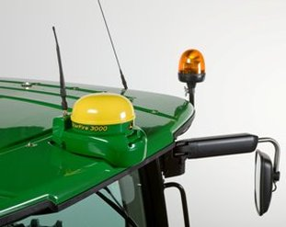
Global positioning Systems
A system using satellite signals (radio-waves) to locate and track the position of a receiver and/or antenna on the Earth
It can return you to an exact location in a field to measure fertility, pests, yield, etc.
Simply put, it tracks the location of equipment in a field
Notes:
Both of these definitions are from the Precision Ag Basics book
Why would we want to return to an exact location multiple times?
One reason would be if we put a soil moisture probe or device out in the field and we want to go pick it up at the end of the season. Another example would be to test a certain area multiple years in a row so you can pick up on trends.
Additionally, maybe you are working to mitigate compaction in your field. You can do this by driving in the same tractor tracks as much as possible. These systems can help keep you in those tracks so less of your field is drove over. (Over 85% of compaction happens on the first pass over an area of ground! So basically, driving over the same area is better than spreading out your equipment passes over the whole field).

Slide 19
Let’s take a deeper look at GIS
Software
GIS
Remote Sensing
GPS
Notes:
You can see if anyone has a guess as to what GIS or what GIS stands for. Both answers are on the next slide.

Slide 20

Geographic information systems
A computer-based system that collects, manages, and analyzes geographic spatial data.
Spatial=anything that occupies space at a given location
  Examples: topography (elevation), yield, soil properties, etc.
Notes:
GIS is like a puzzle. It allows you to put all the pieces together to see how they impact one another.
Definitions from Precision Ag Basics book
Common example: AG Leader SMS. Who has seen those monitors in their cabs before?

Slide 21
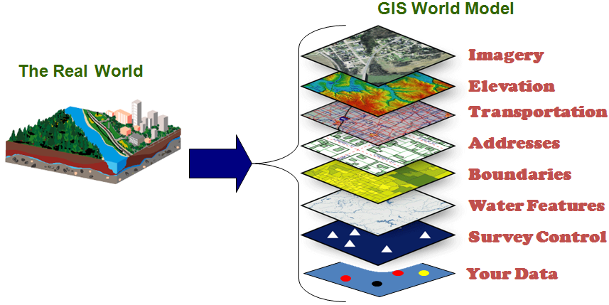
GIS Layers
Photo Courtesy of Henrico County, Virginia
Notes:
GIS consists of spatial representations called “layers” which contain information on several attributes such as elevation, land ownership and use, crop yield and soil nutrient levels
Will have to define what attributes are
In this map here, we can break down what we see on a map as we use navigation on our phones. Maps pull imagery from satellites orbiting the earth. They also will pull in different layers to reveal elevation change, transportation updates for the day, addresses, boundaries around properties and fields, water features such as water sheds, any surveys done by surveying companies or cities, and any other data we have collected. Some ag examples could be soil moisture, soil temperature, planting depth, population, planting speed, etc.

Slide 22
Let’s take a deeper look at remote sensing
Software
GIS
Remote Sensing
GPS

Slide 23
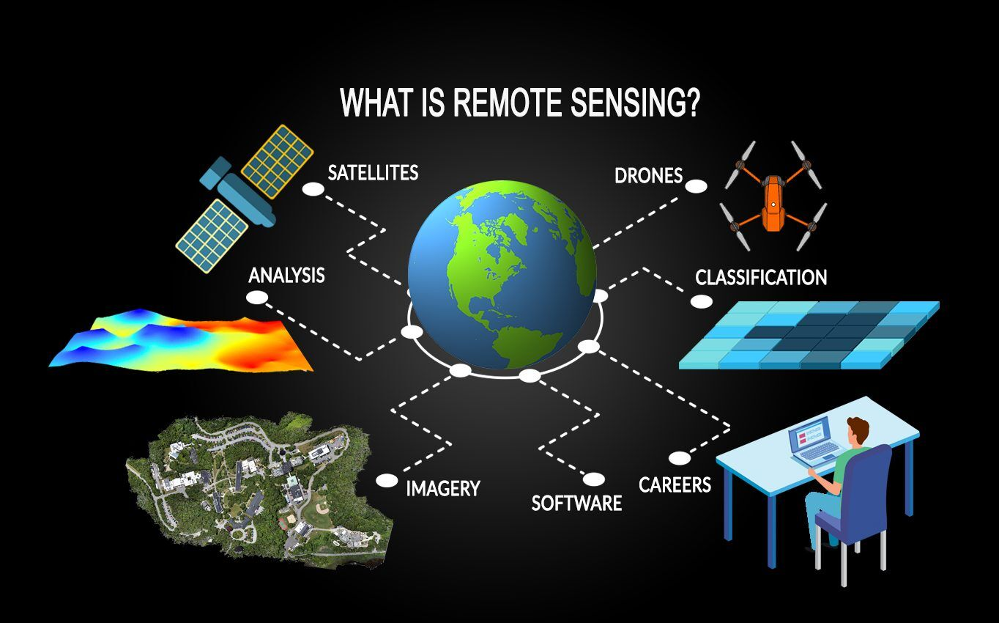
Remote sensing
Notes:
Definition: the collection and interpretation of information about an object, such as a field, from a remote vantage point without making physical contact (Johannsen & Carter, 2000)
Example: Google Earth satellites capturing imagery of the landscapes of the earth
Flying a field with a drone or airplane to collect images about plant health
Non-ag example: Smart House-check room temperature on your phone

Slide 24
Precision ag tools: recap
Precision Ag Technology
Hardware
Meters
Monitors
Software/Data
GPS
GIS
Remote Sensing
Sensors

Slide 25
How do these things work together?
Technology
Data/
Information
Interpretation/
Decision-making
Notes:
When using precision ag practices (our intentional decision making) we can use all of these to begin to read, interpret, and understand what is going on in our operations on a granular scale.
Inch by inch, seed by seed, cow by cow.
We can work to more deliberately apply our inputs to have positive results on our yield, animal daily gain, and other deliverables.
What are inputs?

Slide 26
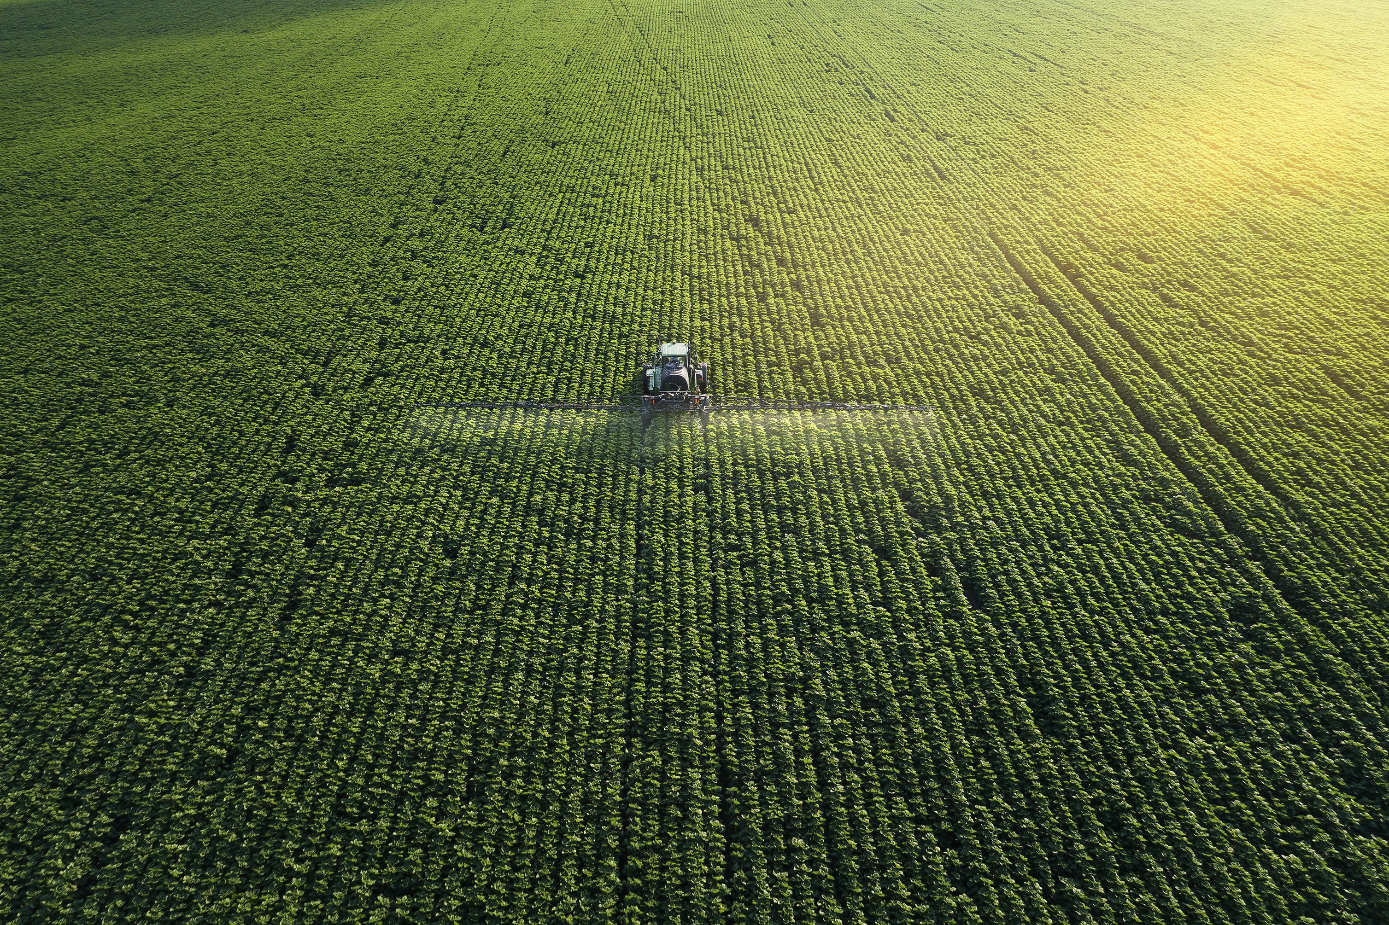
inputs
What inputs can you think of?
Items put into your operation to help you produce your product
    Example: water for animals and for plants
Can be managed and controlled by precision agriculture management practices
Notes:
Examples:
Agronomic Inputs
Seeds
Seed/hybrid/variety -can change as the planter moves across the field
Seed spacing = (seeding rate)
Seed depth
Irrigation
When it’s time to water
How much is applied
Can be varied as the pivot moves across the field
Fertilizer=food for plants
Pesticides
Herbicides=eliminates weeds
Rate can be varied based on weed pressure
Weed types can be ID
Can be shut off in areas where it is against the law to apply (waterways)
Fungicides=controls harmful fungi
Insecticides
Animal Inputs
Temperature of Environment (controlled in closed systems such as barns)
Feed Rations
Water

Slide 27
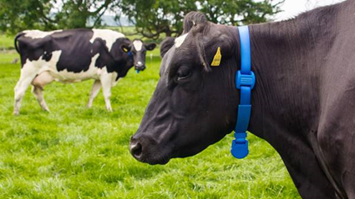
Take a few minutes to complete a computer search on how collars, such as the one shown on this dairy cow, are used in the dairy industry today. Discuss your findings with your class.
Notes:
Bonus Activity: Think of an example in your own daily life where you use different pieces of equipment to monitor data in your life.
Examples could be fitbits to monitor activity, nutritional tracking, GPS phone navigation, any sensor or gauge on your car
Another question you can pose to your students that is a bit deeper is, “Do you think learning how to adopt precision agriculture management methods is worth it?” Do you think it directly affects your life? Or some variation of these questions. Have them pick a side and discuss.

Slide 28
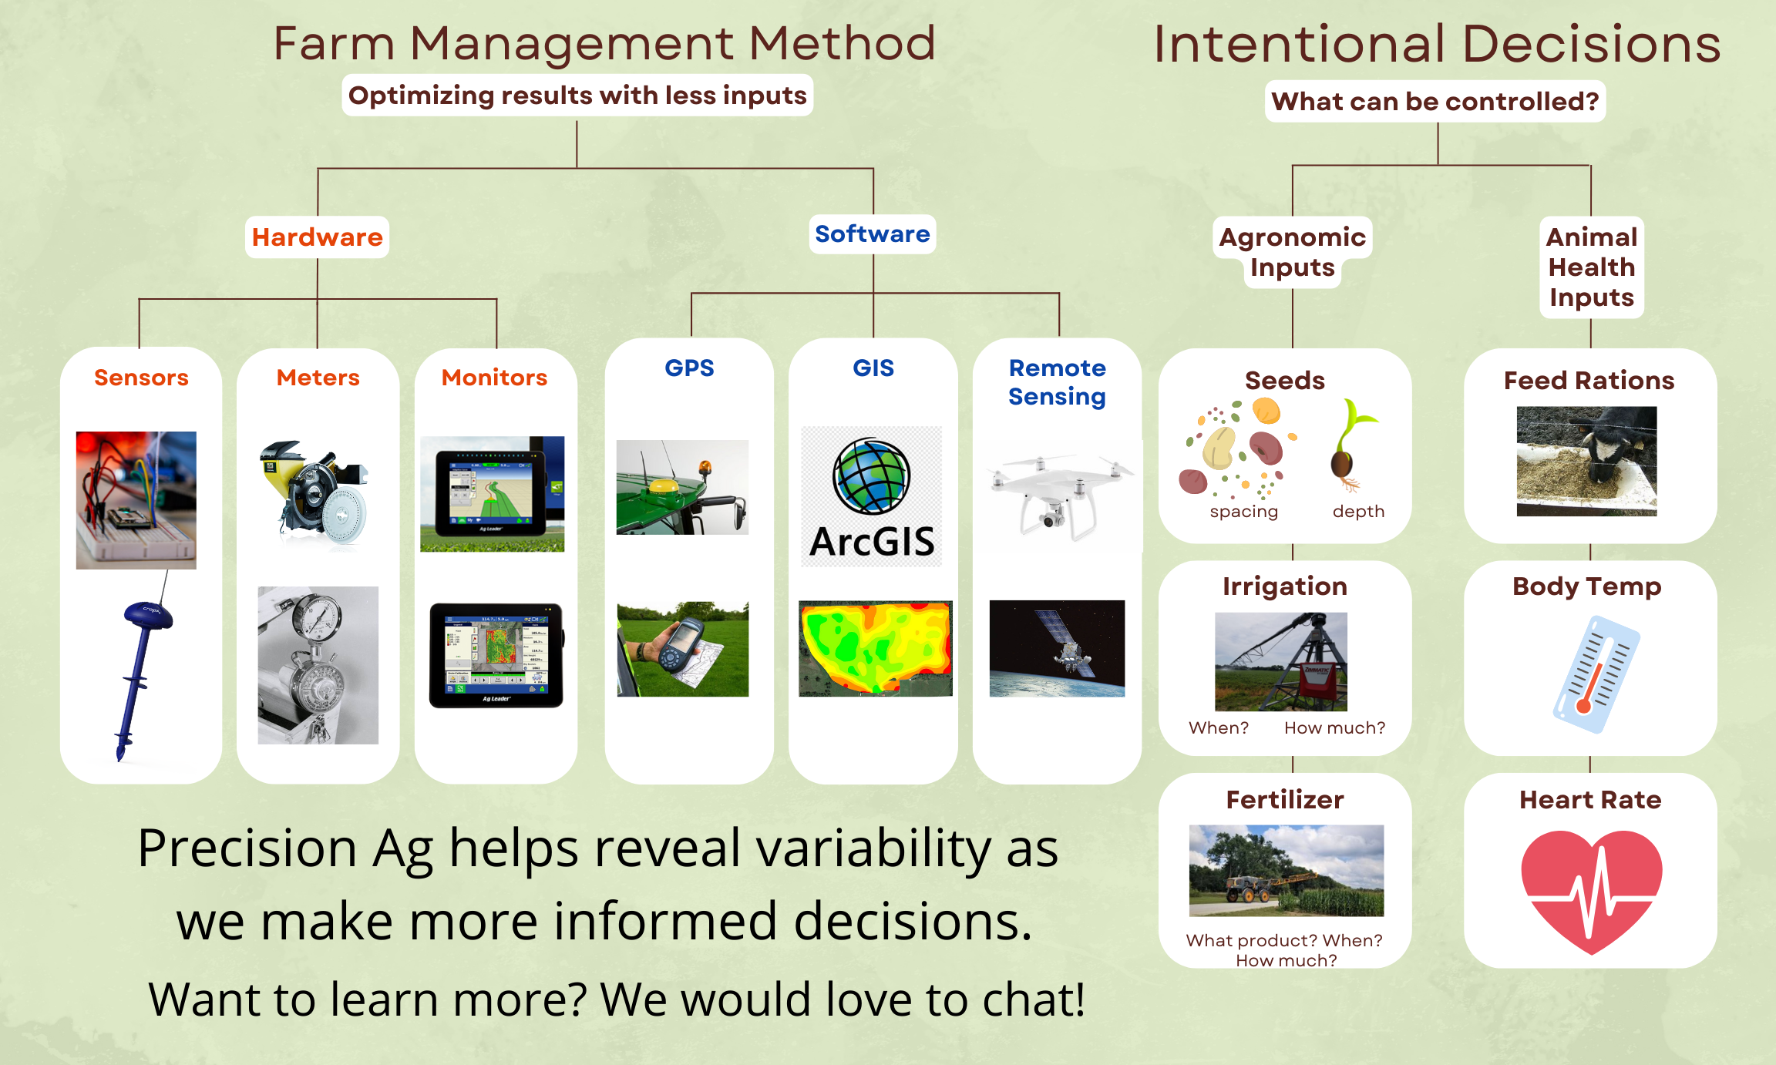
Precision agriculture
Notes:
This slide is a summation of everything that I talked about in this unit. You can use it to recap the lesson. Precision agriculture is a method of farm management. One where we strive to optimize our results with less inputs. We have some tools in our tool box to help us accomplish this including the hardware and software that we talked about. All of these items allow us to collect data to make more informed decisions based on the variability that we see. Intentional decision making allows us to control inputs such as the items you see on the right-hand side of this poster.
Yes, this is a poster that I hang up at the fair, which is why you see the line about “We would love to chat!” on it. Ignore that part.

Slide 29
acknowledgements
This material is based upon work supported by the National Science Foundation under Grant No. 1700680. Any opinions, findings, conclusions, or recommendations expressed in this material are those of the author(s) and do not necessarily reflect the views of the National Science Foundation.
The CHS Foundation, funded by charitable gifts from CHS Inc., is focused on developing a new generation of agriculture leaders for life-long success. Together, with our partners, we are igniting innovation and driving excellence in agricultural education, cultivating high-impact programs for rural youth and accelerating potential for careers in agriculture. Learn more at chsfoundation.org.
Notes:
Acknowledgements of the grants that graciously helped make this possible.

Slide 30
Works cited
Home. Instruments Direct. (n.d.). Retrieved August 2, 2022, from https://www.instrumentsdirect.com/products/flow/flow-meters/?msclkid=c7706f98225917c167250d71451299d0&utm_source=bing&utm_medium=cpc&utm_campaign=S+%7C+Cat+%7C+Flow+%7C+Flow+Meters&utm_term=%2Bflowmeter&utm_content=flow+meter+%28b%29
Johannsen, C. & Carter, P. (2000). Reference D in Precision Farming Profitability. Purdue University.
OmegaEngineering1. (2018, September 11). What is a flow meter and how does it work? explained. YouTube. Retrieved August 2, 2022, from https://www.youtube.com/watch?v=f9LFJOno96c
SmartFirmer. Precision Planting. (n.d.). Retrieved July 20, 2022, from https://www.precisionplanting.com/products/product/smartfirmer
Notes:
What is Remote Sensing? The Definitive Guide - GIS Geography
Geographic Information Systems (GIS) - Henrico County, Virginia

